Slide 1
Prediction Of Brain Connectivity Values
Kaggle group ID: 150140011_150140007_150150026
O. Kürşat Karayılan, Muhammed Said Dikici, Selim Enes Kılıçaslan
Kaggle rank: 10

Slide 2
What is our main goal?
Our main goal is predicting brain connectivity features by using different type of machine learning techniques. We are given two datasets which are train_t0 and train_t1. Brain connectivity features measured at two different timepoints t0 and t1, spaced out by 6 months. Our aim is to predict what could be the values after six months given each brain dataset.

Slide 3
Proposed solution
Clear the data from redundant values
Use PCA to reduce dimensions
Apply SVR algorithm

Slide 4
1) Clear the data from redundant values
We deleted ID columns in order to not include them into computations. Other than that we found some duplicated and empty columns and deleted them.

Slide 5
2) Use PCA to reduce dimensions
In order to reduce dimensionality and mean squared error we used Principal Component Analysis (PCA). We tried different number of component amount. We found that optimal component quantity is 11 in our model.

Slide 6
3) Apply SVR algorithm
Since SVR’s output is a single column, we created the model for each column.
With the help of scikit-learn.org we optimized some of our parameters with GridSearchCV.

Slide 7
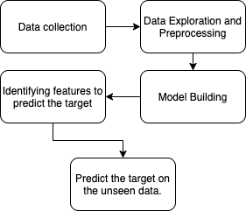
Learning Pipeline

Slide 8
Code demo using Python and 5-fold CV

Slide 9
How to further improve our model?
Fine tuning hyperparameters

